Slide 1
3. Language Fundamentals

Slide 2
Structure of Memory
Memory
Data Segment
Stack Area
Heap Area
Data Section
Local Variables
Movable
Boundary
Dynamically Allocated
Variables
Fixed
Boundary
Global and Static
Variables
Code Segment

Slide 3
Memory Management
Automatic memory allocation and de-allocation
A garbage collector is responsible for
De-allocating memory
Recovering memory used by objects that are no longer reachable from references in executing code.
Java doesn’t allow memory leakage.
Garbage Collector(referred as GC) automatically de-allocates memory.
It de-allocates memory of objects that no longer has any references i.e., reference count is zero.

Slide 4
Garbage Collection
Java provides automatic memory management through a program called Garbage Collector.
Remove objects that are not used anymore.
Live Object: reachable(referenced by someone else)
Dead Object: unreachable(not referenced from anywhere)
Based on following hypothesis:
Most Objects soon become unreachable
i.e., references from “old” objects to “young” objects only exists in small number.

Slide 5
Unreachable – out of scope(objects are out of scope as soon as method execution is complete or the if block is over) and those can be garbage collected.
Objects which is being survived for long time – old objects
System.gc() or Runtime.getRuntime.gc() these method run garbage collector.

Slide 6
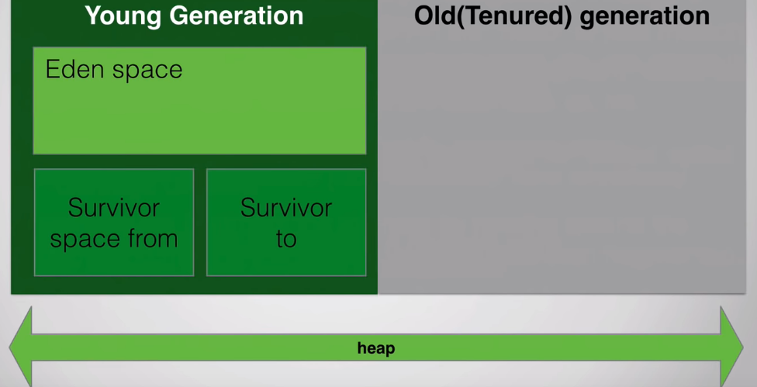

Slide 7
Garbage Collection Phases
Phase 1: Mark
Identifies live object references or application roots and builds their graph.
Objects not in the graph are not accessible by application and hence considered garbage.
Finds the memory that can be reclaimed.
Phase 2: Compact
Moves all the live objects to the bottom of the heap, leaving free space at the top.
Looks for contiguous blocks of garbage objects and shifts the non-garbage down in the memory.
Updates pointers to point new locations.

Slide 8
Performance
Responsiveness/Latency-
How quickly an application response with a requested piece if data.
Ex.
How quickly a desktop UI responds to an event.
How fast a website returns a page.
How fast a database query is returned.
For applications that focus on responsiveness, large pause times are not acceptable. The focus is on responding in short periods of time.

Slide 9
Throughput-
Throughput focuses on maximizing the amount of work by an application in a specific period of time.
Ex.
The no. of transactions completed in a given time.
The no. of database queries that can be completed in an hour.
High pause times are acceptable for applications that focus on throughput. Here quick response time is not a consideration.

Slide 10
Garbage Collector
1. A Serial Collector
Basic garbage collector that runs in single thread, can be used for basic applications.
2. A Concurrent Collector
A thread that performs GC along with the application
Execution as the program runs, does not wait for old generation to be full – stops the world only during mark/remark.
3. A Parallel Collector
Uses multiple CPUs to perform GC. Multiple threads doing mark/sweep etc. Does not kick it until heap is full/near-full. Stops the world when it runs.

Slide 11
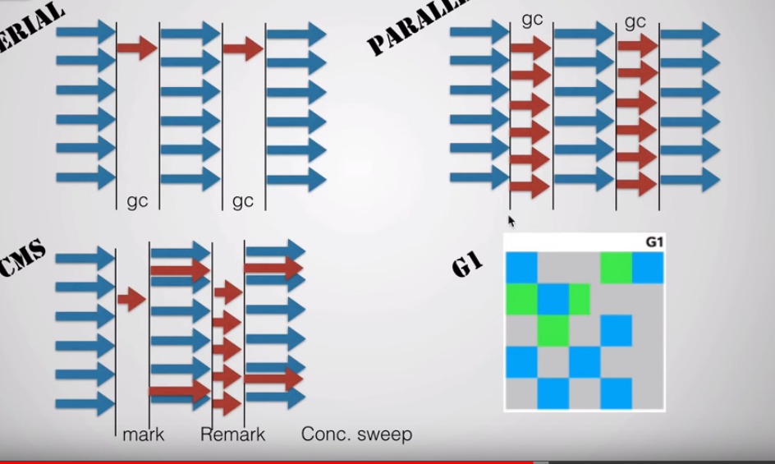

Slide 12
GC: Concurrent vs. Parallel
Use concurrent collector(CMS) when
There is more memory
There are number of CPUs
And for those applications that demands short pauses.
Most favored gc for most of web applications.
Use a parallel collector when
There is lesser amount of memory.
There are lesser number of CPUs.
And for those applications which demand high throughput and can withstand pauses.

Slide 13
G1 Garbage Collector
In Java 7 has new garbage collection strategy by default. It is called G1, which is short for Garbage first.
It replaces the regular Concurrent Mask and Sweep Garbage Collectors with increased performance.

Slide 14
G1 Garbage Collector
In G1 garbage collector heap is divided into regions and they are garbage collected in parallel fashion depending on whoever has more amount of garbage and again the whole concept of young and old .. And Eden and survivor they all are divided into small regions and all managed.

Slide 15
finalize()
Garbage collector reclaims orphaned object spaces.
finalize() can be overridden by a class, executed implicitly when GC is about to run.
Generally overridden to perform termination housekeeping on object just before java garbage collects the object.
finalize() method receives no parameters and return no value.
Using finalize() is imp. When dealing with non-java resources that are too valuable to wait until garbage collection. For example, open files cannot wait until finalize phase has to be reclaimed. There is no guarantee that the object holding the open file will be garbage collected before all the open file resources are used up.
Objects that allocate external resources should provide a finalize method that cleans them up or class may create a resource leak.

Slide 16
Example :
public class JavafinalizeExample1 {
public static void main(String[] args)
{
JavafinalizeExample1 obj = new JavafinalizeExample1();
System.out.println(obj.hashCode());
obj = null;
// calling garbage collector
System.gc();
System.out.println("end of garbage collection");
}
@Override
protected void finalize()
{
System.out.println("finalize method called");
}
}

Slide 17
Parameter passing in java(call by value)
In java parameter passing is done “by value”.
When passing primitive data types a copy of variable is created on the stack.
While passing objects as parameters the references are passed by value(a copy of reference “not the object” is created on the stack).
There is only call by value in java, not call by reference. If we call a method by passing a value, it is known as call by value.
The changes being done is the called method, is not affected in the calling method.

Slide 18
Arrays
Normally, array is a collection of similar type of elements are stored in contiguous memory location.
Arrays are first class objects in java.
The actual array is created on heap.
Arrays references are stored on stack.
We store only fixed set of elements in java array.
Array in java is indexed based, first element of array is stored at 0 index.

Slide 19
Advantages of Java Array:
Code Optimization: It makes code optimized, we can retrieve or sort the data easily.
Random Access: We can get any data located at any index position.
Disadvantages of Java Array:
Size Limit : We can store only fixed size of elements in java array. It doesn’t grow its size at runtime. To solve this problem, collection framework is used in java.

Slide 20
Types of Array in java:
One dimensional array
int arr[];
arr = new int[4];
int arr[] = {10,20,30,40,50};
MyDate[] md;
md = new MyDate[2];
Multidimensional array
int[][] a = new int[2][4];//two rows and three columns
int [][]n = new int[][]{{1,2},{3,4},{5,6}};

Slide 21
Enhanced For Loop(for each)
for each loop is designed to cycle through a collections of objects, such as an array, in strictly sequential manner, from start to end.
Traditional looping structure will work as follows:
int num[] ={1,2,3,4,5};
int sum = 0;
for(int i=0;i<num.length;i++)
{
sum+=num[i];
}

Slide 22
for each loop automates preceding loop. It eliminates loop counter, starting and ending value and manually indexing of array.
When a program has to iterate over Arrays or Collection then there is one form of for statement called enhanced for loop which is introduced in Java 5.
Cannot remove elements from collection.
Gives read-only data and hides the iterator.
Used to traverse over collection in forward direction.
Syntax:
for(type var:collection/array)

Slide 23
Example:
int []num = {1,2,3,4,4,5,6};
for(int i:num)
{
sysout(“Count is: ”+i);
}

Slide 24
Example :
public class Demo1 {
public static void main(String[] args) {
int [][]arr = {{1,2,3},{4,5,6},{7,8,9}};
for(int i[]:arr)
{
for(int j:i)
{
System.out.print(j+"\t");
}
System.out.println();
}
}

Slide 25
Containment
One Object may contain another as a part of its attribute.
ex. Document contains sentences which contain words.
The containment need not be physical
ex. Computer system has a warranty.
Containment types:
Composition
Aggregation

Slide 26
Composition(tightly coupled):
is usually implemented such that an object contains another object.
Aggregation(loosely coupled):
The object may only contain a reference or pointer to the object and not have lifetime responsibility for it.

Slide 27
Composition is more restrictive. When there is composition between two objects, the composed object cannot exist without the other object.
This restriction is not there in aggregation. Though one object can contain other object, there is no condition that the composed object must exist. The existence of composed object is entirely optional.
Example:
A library contains student and books. Relationship between library and student is aggregation.
Relationship between library and book is composition. A student can exist without a library and therefore is a aggregation.
A book cannot exist without a library and therefore is a composition.

Slide 28
Difference between Containment and Inhertiance
Containment(has-a relationship) | Inheritance(is-a relationship)
Is used when the features of an existing class are wanted inside your new class, but not its interface. | Is used when you want to force the new type to be the same type as the base class.
Ex: 1. Computer has a hard-disk 2. Car has an engine, steering wheel | Ex: 1. Computer is an electronic device 2. Car is a vehicle

Slide 29
Final Variable
Final variable specifies that a variable is not modifiable; any attempt to do so flags an error.
If a final variable is a reference to object, it is the reference that must stay the same, not the object.
Final variable must be initialized.
e.g. private final float PI = 3.14f;

Slide 30
Example:
final MyDate bdate = new Mydate(1,1,18);//Assume that 1/1/18 is birthdate
bdate = new MyDate(1,2,80);//illegal, since ‘bdate’ tries to change
//Whereas,
//final variables must be initialized.
e.g.
private final float PI = 3.14f;
final variables are same as const in C++ and #defined constants in C.

Slide 31
Enums
A enum type is a type whose fields consists of a fixed set of constants.
Created using keyword enum
It is a kind of class definition
The possible values are listed in curly braces, separated by commas. By convention the value names are in upper case.
Java.lang.Enum class is an abstract class.
By default, the contants in the enumeration list are assigned the integer values 0,1,2, and so on.

Slide 32
Enumerations are used to create a set of symbolic names that map to numerical values. By using the enum keyword a new “type” can be created. In general, enumerations may be defined as
enum tag{member1, member2, .., member n};
Once an enumeration is defined, variables of that type may be defined.
tag var1,var2,….var n;

Slide 33
Example 1:
enum Month { JAN,FEB,MAR, ... DEC;}
//; -->optional
Internal implementation of enum:
Internally enum's are implemented by using class concept. Every enum constant is a reference variable to that enum type object. Every enum constant is implicitly public static final always.

Slide 34
final class Month extends java.lang.Enum
{
public static final Month JAN = new Month(); public static final Month FEB = new Month();
}
JAN

Slide 35
Following are the rules to write enums:
They can be declared inside or outside class but not within any method
They are by default final
If declared inside class they are static
Their objects cannot be created explicitly as new keyword is not available
Their constructor has to be private
Enums cannot be private, protected, static and abstract.
Enums constants are implicitly public, static and final
The order of appearance of enum constants is called their NATURAL ORDER.

